Slide 1
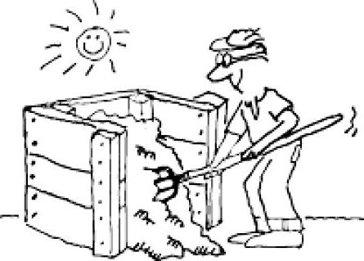
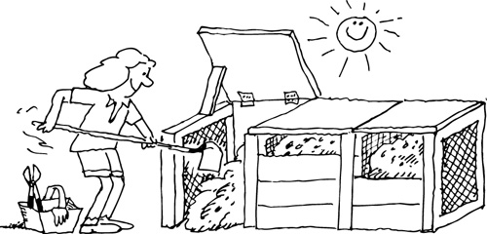

Backyard Composting
How-to advice to get started!
Notes:
Thank you everyone for joining us.
My name is Bert Tejeda.
I work as an automation engineer on the SEI Wealth Platform.
I’ve developed a great interest in sustainable living practices, of which composting is my favorite.
I love this stuff. It smells great, it feeds my lawn, and best of all, I make it myself.
And so on that note, I’ll be presenting you folks with a quick intro to composting.
If anyone has any questions along the way, just raise your hand and ask away.

Slide 2
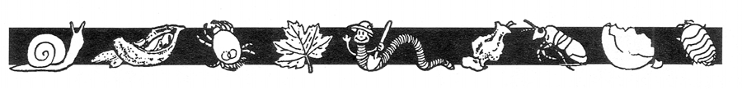
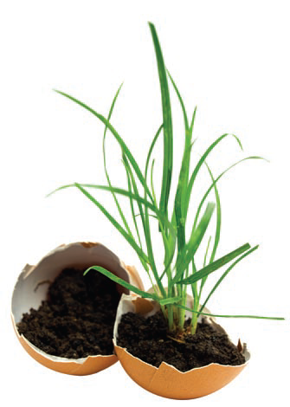
What is compost?
Why start composting?
Building your pile
How do I know it’s done?
How/where do I use my compost?
Troubleshooting
More learning resources in the last slide
Notes:
For the presentation, I’ll go over:

Slide 3
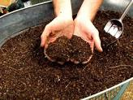
What is Compost?
Organic material from decomposition of carbon (dried leaves), nitrogen (food scraps).
Happens naturally – certain techniques accelerate the process.
Dark, crumbly, soil-like.
Notes:
So what is compost?
In a nutshell, it is “decomposed organic matter, most commonly used as a soil amendment in gardening and farming”
I got that definition from The Joe Gardener Show podcast. The speaker, Joe, has a mantra:
“Feed the soil, and let the soil feed the plants.” Makes sense.
Compost occurs naturally in forests as dead foliage falls to the ground and decomposes, which eventually enriches the soil
You have two main components to the body of an urban compost:
Carbon (or “Browns”) – which can be dried leaves, shredded paper, cardboard, straw, old mulch
Nitrogen (or “Greens”) – food scraps, lawn clippings, the organic component
There’s also water and air of course, which key ingredients if you want to speed up the process and maintain acceptable odor
Bonus: for good aeration, you can introduce into your compost pile weathered pieces of wood like tree branches, large twigs and the like
These will increase particle size variation, which improves overall aeration within the pile
Aeration is good: the critters need space to crawl through the pile and air to breath

Slide 4
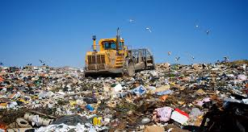
Why is it Important?
Reduces the waste stream. Yard and food waste = 30% of landfill
Improves soil structure.
Retains moisture, slows run-off from rain.
Reduces need for fertilizer
Reduces your carbon footprint
Notes:
So why should you start composting?
Compost is fantastic for food gardens, for farms, and it can even work wonders in your lawn
This is why it’s often called ‘black gold.’
Another great reason to start is waste reduction.
I went from a size 36 to a size 34 in the months after I started my compost pile (j/k)
For me, it was hard work at first, but that’s because I chose to build a 3-tier compost bin out of reclaimed wood in the peak of Summer
There are very easy solutions which I will be sharing information on, along with some techniques to make it an even easier process overall
So again, through waste reduction, you lessen the upward pressure on Landfills.
Very important, as Landfills are one of the largest man-made producers of methane gas, which is the most if not one of the most harmful of the greenhouse gases. Imagine an entire community engaging in this activity; how much waste could be diverted?
Remember less waste = less to landfills, of which PA has plenty
Cost effective
Compost helps you grow healthier plants, vegetables and lawns
Although it is NOT a fertilizer, it does reduce the need for this addition, which saves you money.
Creates earth-safe landscapes
Reduces need for mulch
You’ll use less water, as compost reduces runoff
Compost does contain nitrogen and phosphorus – and trace nutrients that are essential for plant growth, but the main benefit it brings to soil is in its ability to improve nutrient uptake in plants through a process known as ionization, and through the introduction of beneficial microorganisms into the soil
There’s a real science behind it, but it’s not something you need a PHD to get started with; you really can do it in your back yard, and quite cheaply.
The soil in my area has lots of clay, which means water has trouble percolating deep into the soil, which results in standing water and runoff.
By lightly working in compost into my lawn, I can improve water absorption.
This is because doing so will increase particle size variation in the soil, and as I mentioned, introduce microorganisms that can begin working through the soil, opening up pockets for water to seep through, and for other organisms to thrive in, creating a cumulative effect

Slide 5
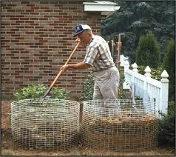
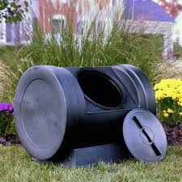
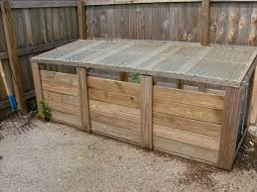
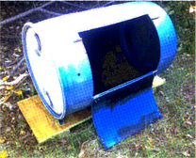
Starting a Compost Pile
Select a location – away from the house
You can make your own or purchase
Notes:
Here are some tips for a more favorable composting experience:
When planning for a compost pile:
In the shade vs fully exposed to sunlight
Don’t create an eye-sore for neighbors
Tuck compost out of sight as best you can.
Some people grow flowers or shrubs to camouflage the bin
Position it so it won’t interfere with your lawn & gardening activities
In a well-drained area
Near the garden so you don’t have to carry your inputs too far

Slide 6
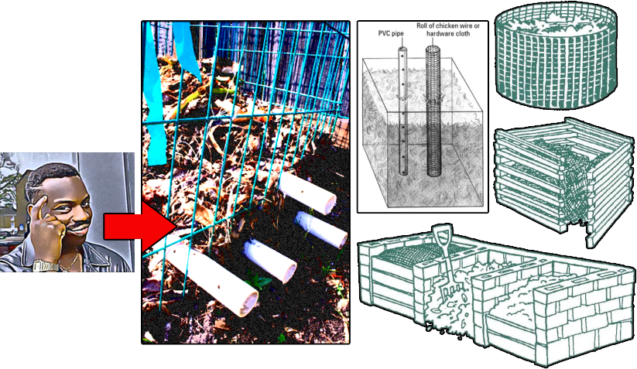
Compost Bins
- Ideal size is 3-4 cubic ft. (27-36 cubic ft.) Easier to turn, aerobic action
No larger than 5 x 5 x 5
Can become anaerobic (not enough oxygen)
Notes:
Here are more ideas for creating a workable bin in your yard.
Cinder block works well – open side for easier turning.
Wooden pallets make a great compost bin too – and allow for air circulation
If you really want to get fancy, you can insert perforated pipes to get air into the core
This will reduce the need for you to turn the pile

Slide 7
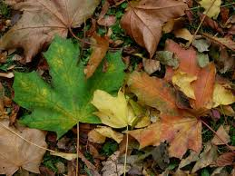
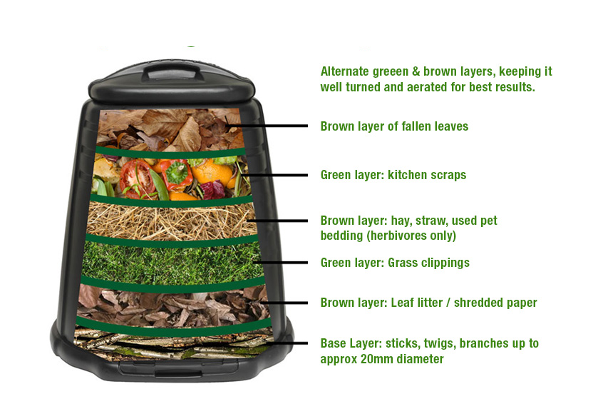
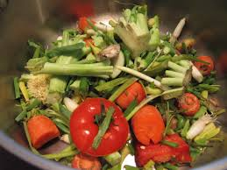
What goes in your Compost?
Carbon: dried leaves, cardboard, paper, pulp, straw
Nitrogen: food scraps, plants
Water/Moisture
Oxygen
Notes:
Moisture is critical to allow bacteria to work – grab a handful of your compost and squeeze
It should be consistency of wet sponge
If too wet, add browns such as shredded newspaper
It it’s too dry, add water
Over time, you’ll learn to eyeball it

Slide 8
Ratios
Try to maintain a 3 to 1 Carbon/Nitrogen Ratio
BROWNS | GREENS
Dried leaves | Kitchen scraps
Straw | Coffee grounds & filter
Shredded paper | Tea bags
Drier lint | Yard clippings
Newspaper | Pet hair
Pine needles | Manure (from herbivores*)
Sawdust
Paper bags
Notes:
Browns and greens are easy to remember
These are some samples of each
Typically a 3:1 ratio
Another way to remember how much to add – just think equal amounts based on weight
A large bag of dry leaves weighs less than a small bag of kitchen scraps – so more leaves than kitchen scraps
You can (but don’t have to) chop the inputs for quicker decomposition
If you plan to add manure, do your research
I’ve read about people who incorporated horse manure into their piles only to find out that the horse dung contained still active herbicides which wrecked havoc on their compost and subsequently their gardens

Slide 9

A Few Things to Avoid
- Meat, bones
- Dairy products
- Fats and oils
- Pet feces (dog, cat, other carnivores)
These can attract critters you don’t want, may create odd odors, or contain harmful bacteria/parasites.
Notes:
Also omit hard-to-kill weeds such as quackgrass and weeds that have gone to seed.
Normally this is not a problem for large-scale composting operations, where internal temperatures can reach as high as 170 degrees F, which kills the seeds
In a residential setting, the compost pile’s internal temperature doesn’t normally reach this peak, so it’s best to avoid weeds altogether
Do not add diseased plants such as tomato plants or fruit that are diseased
Also, avoid rhubarb and walnut (leaves, shells) – these contain substances toxic to insects (the ones eating your compost) or other plants after you spread the compost.
If you have chickens and plan to incorporate compost into your feed, don’t add avocado scraps
Avocado skin and pits contain persin, which is toxic to chickens

Slide 10
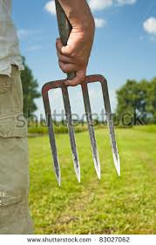




Turning your pile adds Oxygen
Keep the worms, bugs, microbes happy and eating your browns and greens.
Use a pitch fork to turn the pile.
Notes:
No, not the kind of pitch fork angry mobs carry, and definitely not the one Beethoven used for getting his music right.
You want the garden center or farm supply store kind of pitch fork
Something that lifts and separates your compost while you turn it

Slide 11
Active (hot) vs. Passive (cool)
Hot composting
Involves creating ideal environment for microbial processes.
Piles require more attention.
Temperatures reach 110 to 140.
Compost can be finished in three to four months.
Cool composting
Continuous pile. Add material as it’s available.
Trench. Kitchen scraps placed 12” deep and covered immediately. Typically near garden.
Sheet. Layers of newsprint, yard waste, dried leaves. Ready in six to eight months (next season).
Notes:
I’m employing cool composting, as I don’t have enough time on my hands to micromanage my piles
If you’ve purchased a hot composting bin, it’ll be easier for you to go down that route

Slide 12
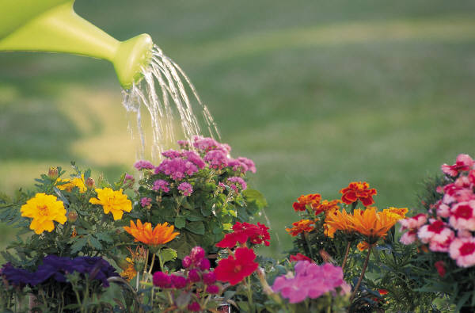
How to use your Compost
Mulch for garden, fruit trees
Top dressing on flowering plants
Soil improvement, helps to change structure
Enhances moisture retention in sandy soil
Improves drainage in clay soil
Attracts earthworms which aerate soil
Notes:
When the materials you put in the compost are no longer distinguishable (e.g. can’t tell a leaf or a banana peel)
Your pile will be about one half of the original mass
Uses
Compost as mulch for trees
Spread it 2 to 3 inches deep out to the drip line of the tree
Mix it in the soil
Spread it 2 to 4 inches deep on vegetable or flower beds
Spread it over your lawn
Manually or you can purchase a green compost spreader (search online)

Slide 13
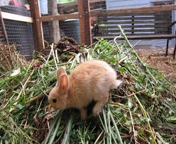
Troubleshooting
Materials not decomposing: Add water, turn pile to add oxygen, add more greens
Ammonia and/or rotten odor:
Add browns such as leaves, straw, or shredded cardboard/paper, bury food scraps, turn pile
Critters in your pile!:
Ensure you bury your food scraps, Cover pile with burlap or hardware cloth
Unrelenting fruit flies from hell (UFFFH):
Make sure to cover your pile in a thick layer of browns, or use fabric such as burlap, placing your compost pile in shade also helps with this, as fruit files favor sunlit areas
Notes:
Don’t make your compost too attractive to animals
You may attract more serious critters that you don’t want
Bury your food scraps in the middle and near the bottom third of the pile and cover your pile with a thick layer of browns
This will reduce the smell of the decomposing matter, thus reducing the chance of an animal being privy to your pile
As a more preventative measure, you can cover your pile with burlap fabric or hardware cloth to keep animals, esp. rodents, out of your compost

Slide 14
Summary: Top 10 Reasons to Compost
10.Be environmentally responsible.
9. Reduce need for chemical fertilizers, mulch.
8. Create a healthy landscape.
7. Improve the quality of your soil.
6. Reduce amount of yard waste going to landfill.
5. Protect the local watershed.
4. Decrease water use in your landscape.
3. Protect privacy. You can use shredded personal papers!
2. It's easy. Good exercise.
1. You can use it to grow your own food!
Notes:
#3 – some kids like to shred their homework – after they get it back from the teacher!
Shred old credit card receipts.
Don’t worry, printer ink breaks down just fine, and does not contain heavy metals as was the case decades ago

Slide 15
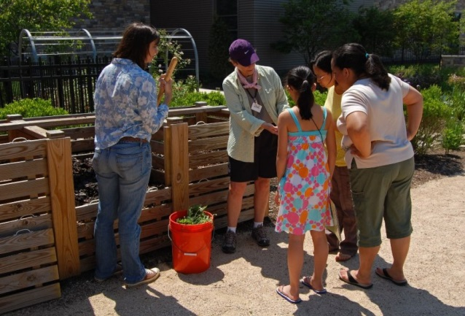
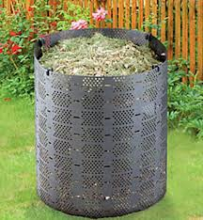
Compost Demonstration Sites
Master Gardeners in our area offer how-to advice at various locations in Montgomery County (PA) from April to November. Call your local recycling program. You may qualify for a free compost bin!
Notes:
Search online using terms like “Master Gardener” or “Master Composter” in the context of your township/locality.
There are events all around where you can get educated

Slide 16
Resources to Learn More
The Complete Guide to Home Composting by Joe Gardener https://joegardener.com/resources/
My online personal knowledge repository on Composting https://github.com/berttejeda/bert.composting
Check nearby nurseries, libraries, B&N, etc Let Me Google That For You
Notes:
Check out the Joe Gardener website for his free PDF on composting at home
Also, periodically check my Github repository on composting.
I’ll be caching everything I learn and gather in that resource.
Local nurseries may have interesting resources on gardening and composting
I’d say libraries and B&N stores for sure
Do check these out!

Slide 17
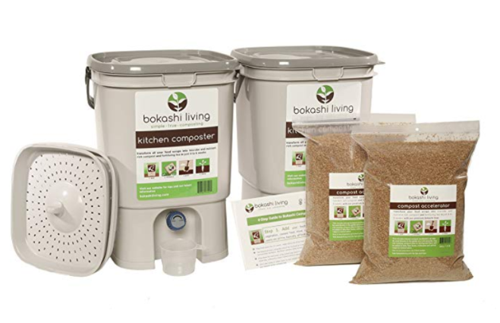
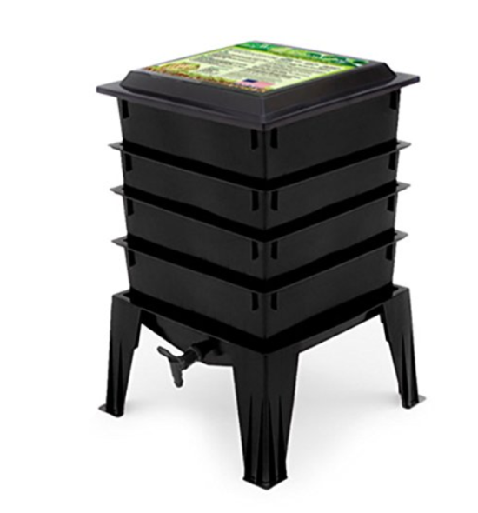
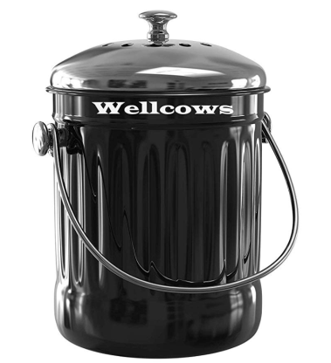
Shopping List
Bokashi Composting Starter Kit (amazon.com)
Worm Factory 360 WF360B Worm Composter (amazon.com)
Vremi Kitchen Compost Bin for Counter or Under Sink - 1.2 Gallon (amazon.com)
Notes:
These are some products you folks can look at on Amazon
I actually use the second item here, and have had great results
My food-waste to food-security workflow is:
Throw food-scraps and browns in the Kitchen compost bin
On average, it fills up every 8 days or so, afterwhich I
Empty the contents into my ‘active’ compost pile
Add browns and moisture if needed
Turn the pile with my pitch fork
In the Winter time, I utilize bigger containers as intermediary holding bins to lessen the need to out in the bitter cold

